Slide 1

Hello world kernel module
Giảng Viên: Lưu An Phú

Slide 2
Agenda
Introduction
Setup environment for development
Create Hello world kernel module
Home work

Slide 3
Introduction
Can extend kernel code when needed
Interact with kernel to become only one kernel process
Code instruction has same priority with kernel

Slide 4
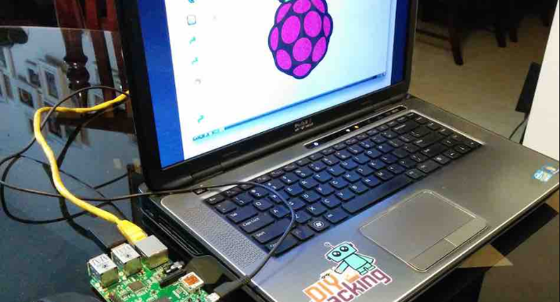
Setup environment for development

Slide 5
Hardware
Board
Pi
Good support from community
Poor hardware document
Udoo
Good hardware document
Should use Udoo for development

Slide 6
Firmware
Download firmware from main page
https://www.raspberrypi.org/downloads/raspbian/
Install firmware
Install Window's tool to write firmware for sdcard
https://www.raspberrypi.org/documentation/installation/installing-images/README.md
Plug in sdcard, power cable, mouse, keyboard and monitor for Pi

Slide 7
Connect PC with board
Install MobaXterm for PC
https://mobaxterm.mobatek.net/
Setup network to connect Pi with PC
Set static IP for Pi and PC
Install ssh tool for Pi
Create new session in MobaXterm to ssh with Pi

Slide 8
Install kernel header in Pi
It include all source header need to develop kernel module
It is generate when they build kernel image
Each kernel instance has only one kernel header
sudo apt-get install raspberrypi-kernel-headers

Slide 9
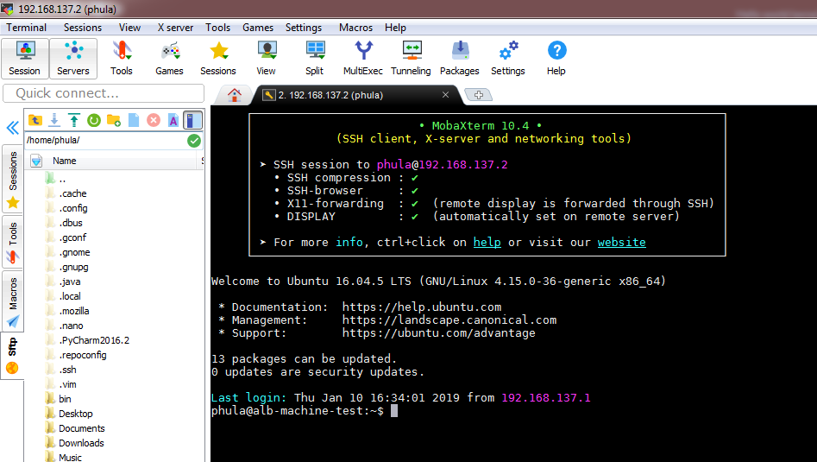
Final result

Slide 10

Create Hello world kernel module

Slide 11
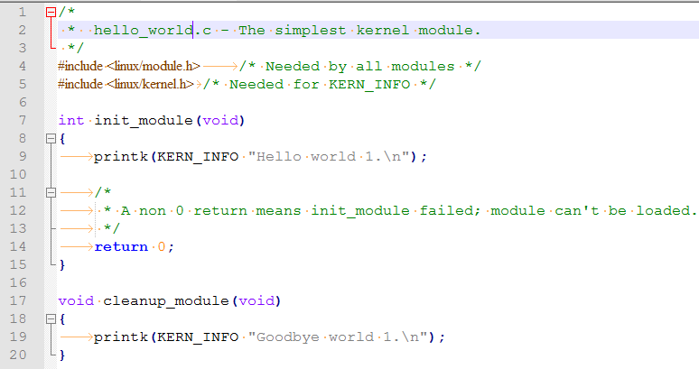
Source code

Slide 12
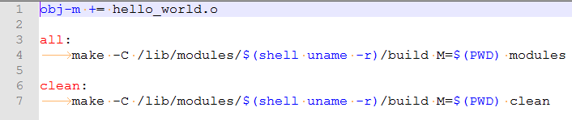
Compile kernel module
Create makefile to compile
make

Slide 13
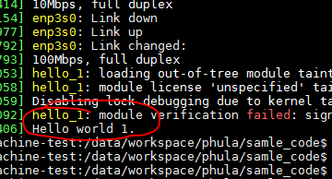
Load and test result

Slide 14
Home work
Kết nối đèn led với chân GPIO của board. Đọc RM để biết cách cài đặt chân GPIO của board. Viết 1 kernel module để mỗi khi load lên sẽ bật đèn led, unload sẽ tắt đèn led.
Tham khảo các hàm sau:
devm_ioremap_resource
__raw_writel
https://youtu.be/3MY8kLEZr98

Slide 15
Thank you

